Slide 1
Ambient Light at Night and Breast Cancer Risk: A Case-Control Study in Canada
Jennifer Ritonja¹, Michael McIsaac², Eric Sanders¹, Christopher C.M. Kyba³, Anne Grundy⁴, John J. Spinelli⁵, Kristan J. Aronson^{1,6}
1. Dept of Public Health Sciences, Queen’s University, Kingston, ON, Canada
2. Dept of Mathematical and Computational Sciences, University of PEI, Charlottetown, PEI, Canada
3. GFZ German Research Centre for Geosciences, Postdam, Germany
4. Centre de recherche du CHUM, Montreal, PQ, Canada
5. Population Oncology, BC Cancer, and School of Population & Public Health, University of British Columbia, Vancouver, BC, Canada
6. Cancer Research Institute, Division of Cancer Care and Epidemiology, Queen’s University, Kingston, ON, Canada
***PRELIMINARY WORK: THANK YOU FOR NO PHOTOS OR TWEETS***

Slide 2
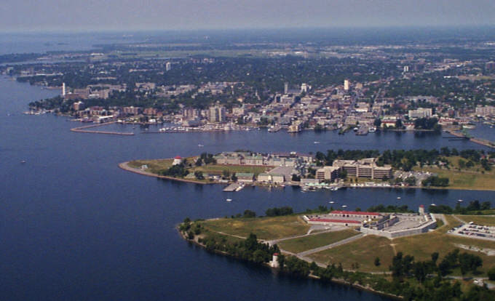
Kingston, Ontario: Traditional Anishinaabe and Haudenosaunee Territory Pop ~ 124,000

Slide 3
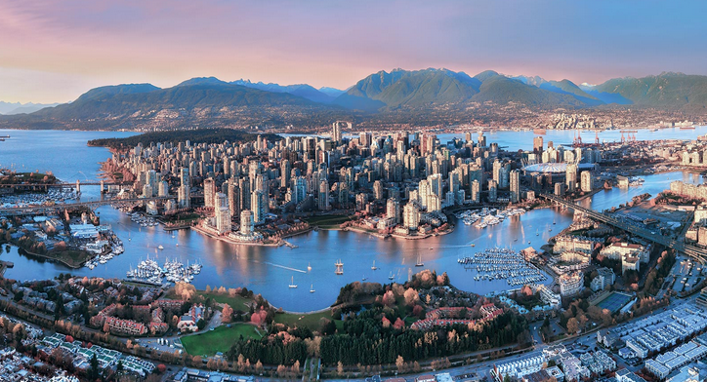
Vancouver, British Columbia: Traditional Musqueam, Squamish and Tsleil-waututh First Nations Territories Pop ~ 2.4mill

Slide 4
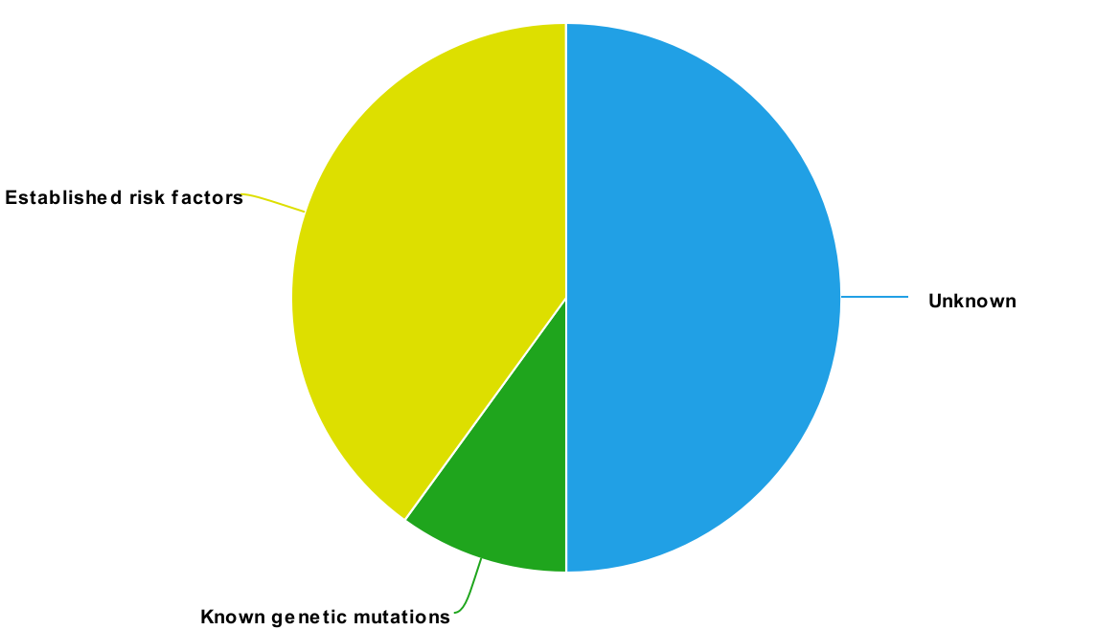

Background
Breast cancer → most frequent cancer among women globally
Established risk factors
Light at night?
30-40%
~50%
Unknown
5-10%
Known genetic mutations
Notes:
According to IARC, breast cancer is the most commonly diagnosed cancer in women worldwide (24.4%). This means that about 1 in 4 new cases of cancer diagnosed in women worldwide is breast cancer.
It is estimated that about 50% of breast cancer causes are still known
Approximately 5-10% are due to known genetic mutations, while 30-40% are due to established risk factors, such as physical inactivity, obesity, and high breast density.
Light at night?
50% of breast cancer causes are still unknown
5-10% - known genetic mutations
30-40% - established risk factors
Light-at-night?

Slide 5
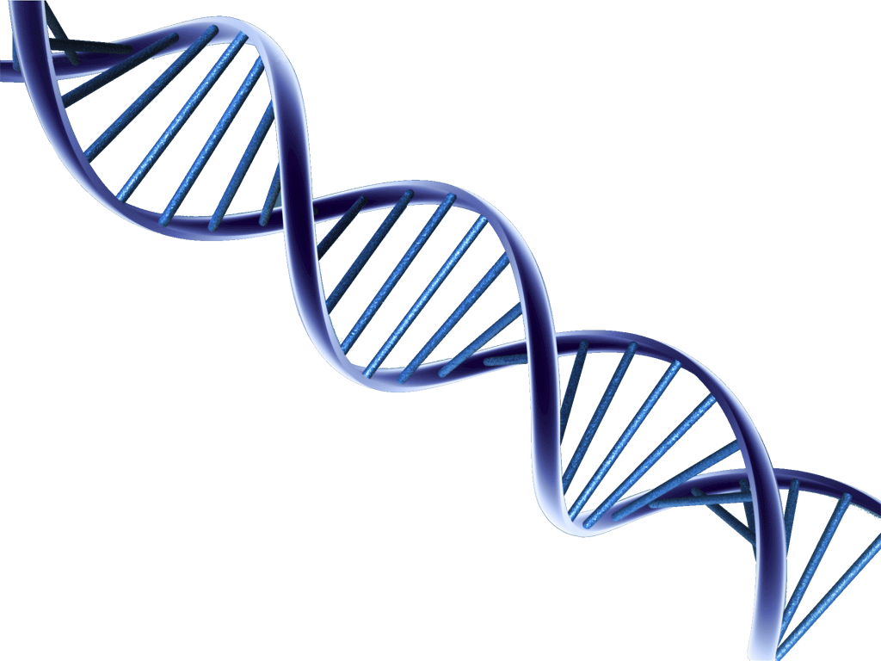
Background
Light-at-night (LAN) theory proposed by Richard G. Stevens in 1987¹
↑ Altered expression of clock genes
↓ Decreased anti-proliferative properties
↑ Breast cancer
risk
↑ Oxidative stress
↑ LAN
↓ Melatonin
↑ Estrogen
1. Stevens RG. Electric power use and breast cancer: a hypothesis, Am J Epidemiol, 1987, vol. 125 (pg. 556-61)
Notes:
The light at night (LAN) theory was first proposed by Richard G. Stevens in 1987.
The theory states that the increasing use of electric light at night may account for some of the international differences in risk of breast cancer, and for a portion of the rising risk worldwide.
It was proposed that the postulated biological mechanisms was that electric LAN would lower melatonin production by the pineal gland, and that this suppression of melatonin might lead to increased breast cancer risk through a number of interrelated pathways, such as an increase in estrogen production.
Experimental studies support the link between disruptions in melatonin and breast cancer risk.
However, it is still unclear if an increase in LAN exposure is related to an increase in breast cancer risk.
It is also unclear how different aspects of light at night, such as blue light, may impact breast cancer risk.

Slide 6
Background
Limitations of studies looking at LAN and breast cancer risk
Self-reported exposure
Ecological designs – many possible confounders
Lower resolution LAN data
Exposure measurements at one time point
Need for research that combines individual level data with comprehensive measures of LAN
Hypothesis that higher resolution LAN would show stronger associations with cancer risk
Notes:
- Some studies have examined LAN exposure using self-report, which is prone to selection bias and misclassification due to the subjective nature of the questions.
- Many past studies examining objectively-measured LAN exposure and breast cancer risk are ecologic in design, which limits the causal inference due to ecologic bias
Most studies where light is objectively measured have also used lower resolution data, which is criticized for its saturation in the brightest parts of cities, as well as its inability to capture individual-level data. This is prone to confounding from other variables associated with urban life, such as noise and air pollution.
Finally, past studies have also focused on single exposure measures at one time, instead of looking at cumulative residential history
- This highlights the need for research that combines the use of accurate individual level data with a more comprehensive measure of exposure that takes into account full residential histories

Slide 7
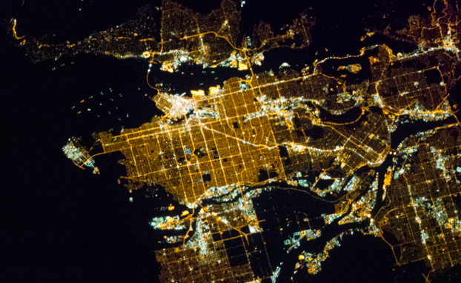
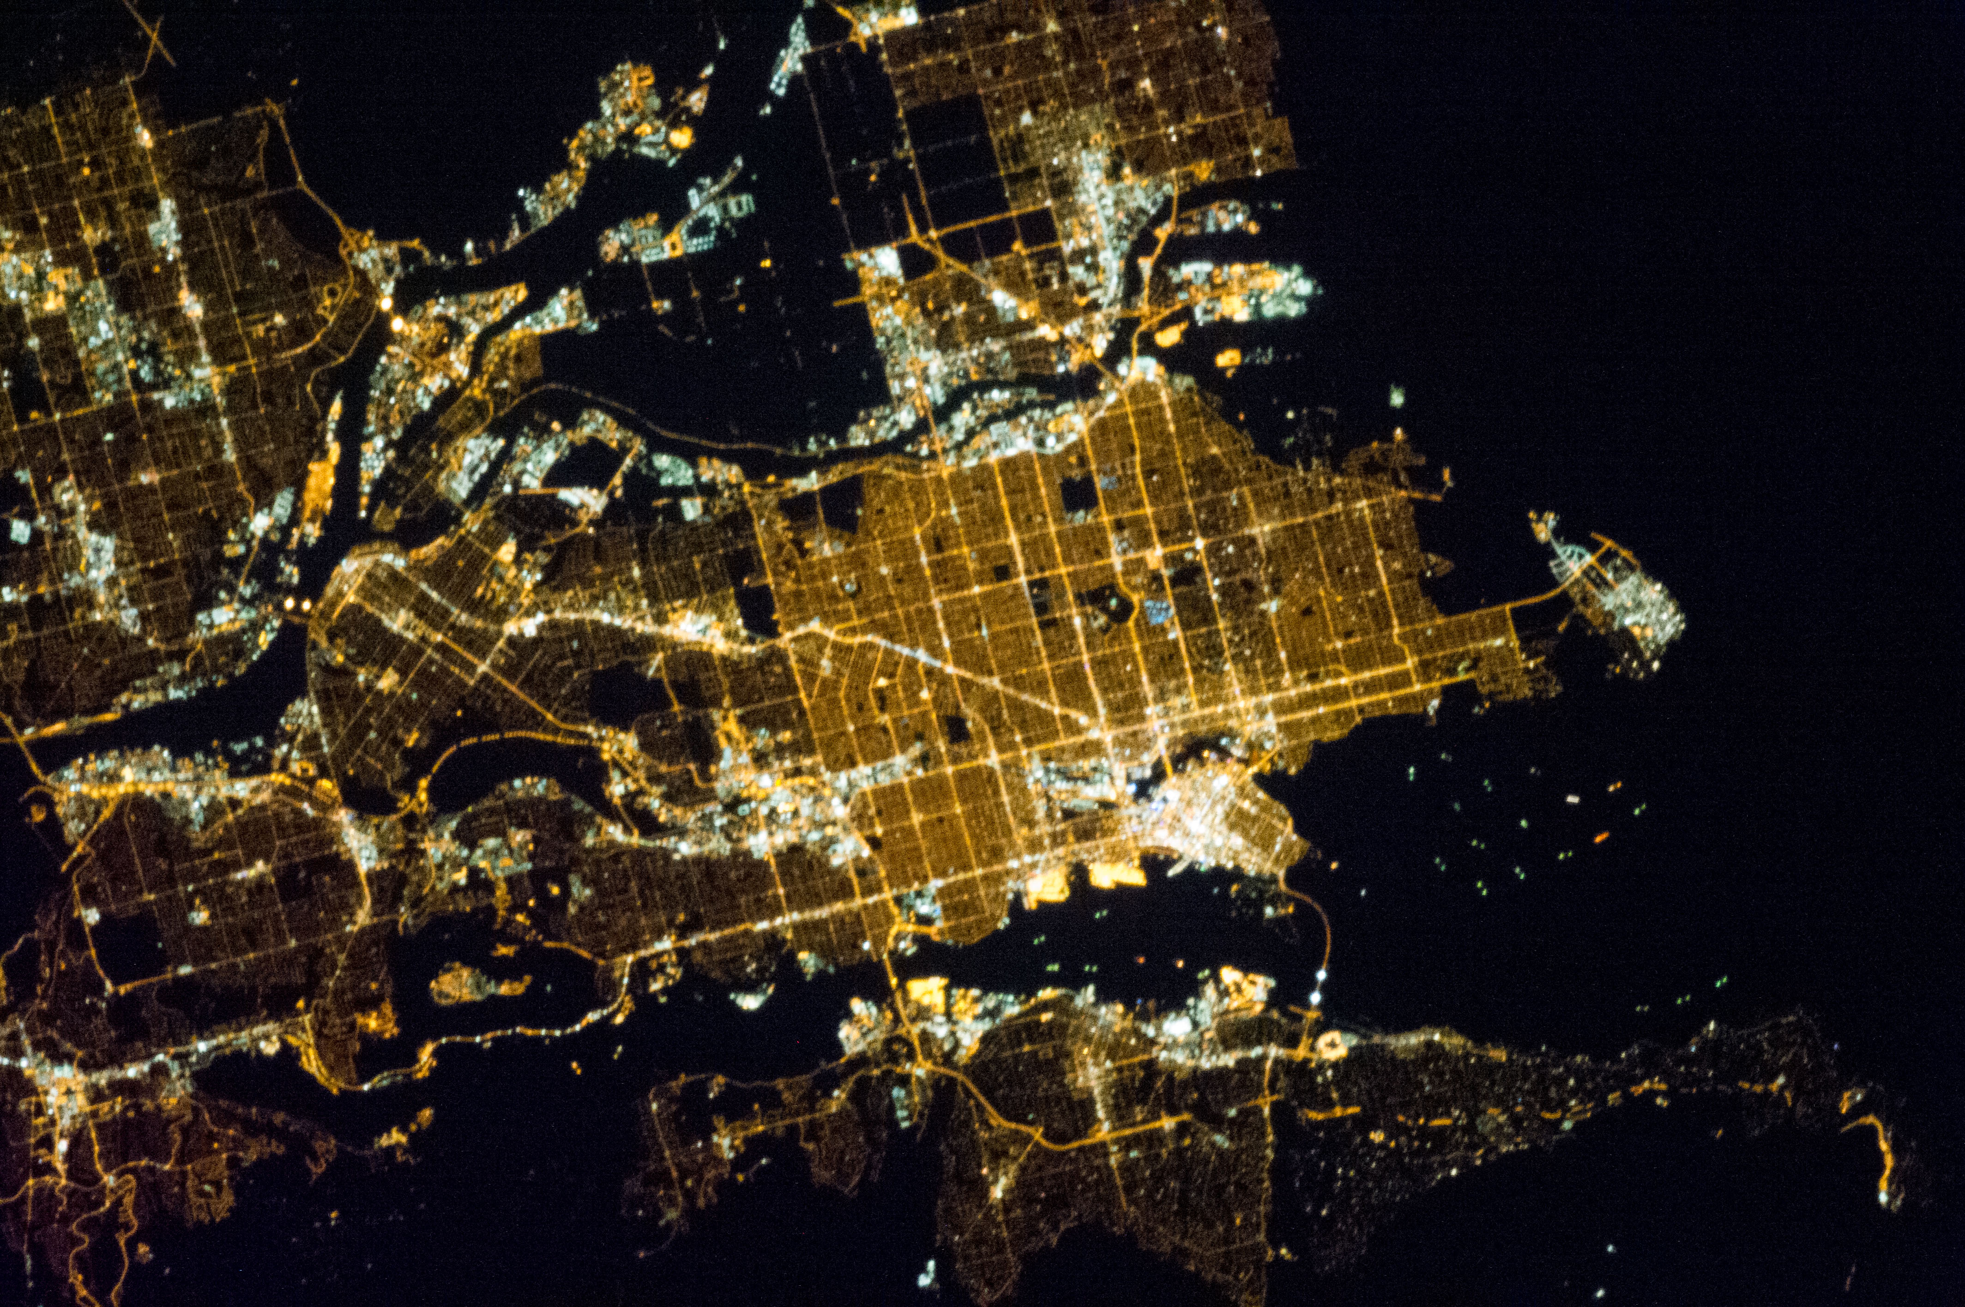
Vancouver, BC – taken on March 31, 2013
49.2827° N, 123.1207° W
Image courtesy of the Earth Science and Remote Sensing Unit, NASA Johnson Space Center
Notes:
My initial hypothesis was that the measurement error induced would be akin to Berkson-type error and so the point estimates would be biased toward the null and power would decrease. However, after looking more at the data that Chris created, it is clear that the measurement error in the exposure measures is not independent of the observed brightness.

Slide 8
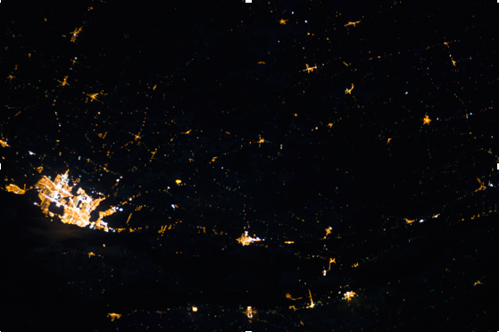
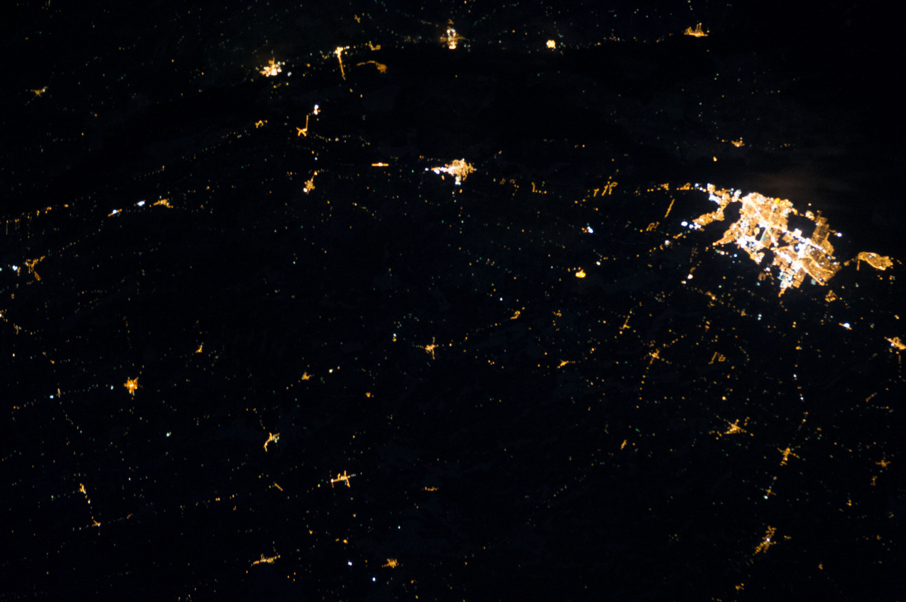
Kingston, ON – taken on Jan 22, 2013
44.2312° N, 76.4860° W
Image courtesy of the Earth Science and Remote Sensing Unit, NASA Johnson Space Center
Notes:
Image of Kingston, taken on Jan 22 2013
44 latitude: about 15 hrs 25min daylight at summer solstice and just under 8 hours in winter
GREATEST thing about Kingston is sitting on back porch on anti-gravity lounge chair to watch the sky

Slide 9
Methods: LAN Sources
Outdoor LAN derived from 3 sources, estimated for each residence:
1) Satellite imagery from the International Space Station (ISS) in 2013
~10m resolution
2) Visible Infrared Radiometer Suite Day-Night Band data (DNB) in 2012
~750m resolution
3) U.S. Defense Meteorological Satellite Program (DMSP) imagery data in 2010
~5-7km resolution
Notes:
Reported addresses for each participant were geocoded, and coordinates were used to extract LAN measurements from 3 sources:
1) Satellite imagery from the International Space Station (ISS)
2) Visible Infrared Radiometer Suite Day-Night Band data (DNB)
3) U.S. Defense Meteorological Satellite Program (DMSP) imagery data
Outdoor LAN exposure for each past residence reported was assigned based on satellite photo data taken in 2010 for the DMSP, 2012 for the DNB, and 2013 for the ISS data.
Note: All addresses were geocoded to longitude-latitude coordinates using the Google Maps database and an app available through Google, and the coordinates were then used to extract DNB measurements using calibrated DNB image data, as well as to extract MSI estimates from the radiance calibrated ISS photo.
We calculated cumulative average outdoor LAN for each participant over their reported residential histories 10 to 20 years before diagnosis for cases, and 10 to 20 years before recruitment time for controls
This time-weighted measure allowed us to accounts for changes in LAN due to changes in a participant’s address over the 10 year period
Notes:
All addresses were geocoded to longitude-latitude coordinates using the Google Maps database and an app available through Google, and the coordinates were then used to extract DNB measurements using calibrated DNB image data, as well as to extract MSI estimates from the radiance calibrated ISS photo.

Slide 12
Background
Studies of shift work exposure and breast cancer risk suggest (many studies…):
Risk may be limited to pre-menopausal women, and estrogen/progesterone receptor positive breast cancer
LAN studies (in their infancy):
Potentially higher risk: Pre-menopausal; night workers

Slide 13
Methods: Population-based case-control study
Conducted in two cities: data collection 2005-2010
Cases: women with newly diagnosed breast cancer
Controls (screened women free of breast cancer) frequency matched to breast cancer cases by age and screening center
Vancouver, BC:
1055 cases; 1016 controls (about 1/3 Asian descent)
Kingston, ON:
131 cases; 164 controls
Primary objectives: shift work; occupational exposures; air pollution
Notes:
Population about 1/3 Asian, different from other studies
Previous research showing 2 to 3-fold increased risk of breast cancer with long term duration working shifts including nights among both healthcare sector and non-healthcare sector workers
Vancouver, BC
Incident breast cancer cases were recruited from the BC Cancer Registry. Inclusion criteria for breast cancer cases were women between 20–80 years of age with a diagnosis of either in situ or invasive breast cancer with no previous cancer history (with the exception of non-melanoma skin cancer). Cases were living in Vancouver, New Westminster, Richmond, and Burnaby at the time of enrollment. Controls were recruited from the Screening Mammography Program of BC (available to women in BC aged 40-79 years) during routine screening mammography and were living in the same geographic areas as cases, frequency-matched to cases within 5-year age groups.

Slide 14
Breast cancer risk associated with years working shifts in health occupations and non-health occupations
Years Shift Work History | Health Occupations OR (95% CI) | Non-Health Occupations OR (95% CI)
None | - | -
0 – 14 years | 0.80 (0.48 – 1.33) | 1.04 (0.84 – 1.29)
15 - 29 | 1.06 (0.58 – 1.92) | 1.05 (0.69 – 1.62)
≥ 30 | 3.11 (1.10 – 8.77) | 2.25 (0.92 – 5.52)
Source: Grundy A, Richardson H, Burstyn I, Lohrisch C, SenGupta SK, Lai AS, Lee D, Spinelli JJ, Aronson KJ. Increased risk of breast cancer associated with long-term shift work in Canada. Occupational and Environmental Medicine 2013;70:831-838.

Slide 15
Methods: Residential histories … to LAN
Objective: to determine if outdoor LAN at place of residence is associated with breast cancer risk
778 breast cancer cases; 830 women without breast cancer
Lifetime residential histories collected using questionnaire; residences geocoded
A priori exposure window: 10-20 years before enrolment in study
Inclusion: at least 1 address in map range during exposure window
Median # of residences = 2
Range = 1 to 10
Average # yrs of residential history = 8.9 yrs
Std. dev. = 2.0 yrs
Range = 6 months to 10 yrs
Notes:
LAN images are proxies for past exposure

Slide 16
Methods: LAN Sources
Outdoor LAN derived from 3 sources, estimated for each residence:
1) Satellite imagery from the International Space Station (ISS) in 2013
~10m resolution
2) Visible Infrared Radiometer Suite Day-Night Band data (DNB) in 2012
~750m resolution
3) U.S. Defense Meteorological Satellite Program (DMSP) imagery data in 2010
~5-7km resolution
Analysis measure: Cumulative time-weighted average LAN for each participant in period 10 to 20 years before enrolment
Notes:
Reported addresses for each participant were geocoded, and coordinates were used to extract LAN measurements from 3 sources:
1) Satellite imagery from the International Space Station (ISS)
2) Visible Infrared Radiometer Suite Day-Night Band data (DNB)
3) U.S. Defense Meteorological Satellite Program (DMSP) imagery data
Outdoor LAN exposure for each past residence reported was assigned based on satellite photo data taken in 2010 for the DMSP, 2012 for the DNB, and 2013 for the ISS data.
Note: All addresses were geocoded to longitude-latitude coordinates using the Google Maps database and an app available through Google, and the coordinates were then used to extract DNB measurements using calibrated DNB image data, as well as to extract MSI estimates from the radiance calibrated ISS photo.
We calculated cumulative average outdoor LAN for each participant over their reported residential histories 10 to 20 years before diagnosis for cases, and 10 to 20 years before recruitment time for controls
This time-weighted measure allowed us to accounts for changes in LAN due to changes in a participant’s address over the 10 year period
Notes:
All addresses were geocoded to longitude-latitude coordinates using the Google Maps database and an app available through Google, and the coordinates were then used to extract DNB measurements using calibrated DNB image data, as well as to extract MSI estimates from the radiance calibrated ISS photo.

Slide 17
Kingston, ON – taken on Jan 22, 2013
44.2312° N, 76.4860° W
Image courtesy of the Earth Science and Remote Sensing Unit, NASA Johnson Space Center
Notes:
Image of Kingston, taken on Jan 22 2013
44 latitude: about 15 hrs 25min daylight at summer solstice and just under 8 hours in winter
GREATEST thing about Kingston is sitting on back porch on anti-gravity lounge chair to watch the sky

Slide 18
Vancouver, BC – taken on March 31, 2013
49.2827° N, 123.1207° W
Image courtesy of the Earth Science and Remote Sensing Unit, NASA Johnson Space Center
Notes:
Image of Vancouver, taken on March 31 2013
Population: about 2.3 million
On 49th parallel
From a point on the ground at this latitude, the sun is above the horizon for 16 hours, 12 minutes during the summer solstice and 8 hours, 14 minutes during the winter solstice^{[1]} This latitude also roughly corresponds to the minimum latitude in which astronomical twilight can last all night near the summer solstice.

Slide 19


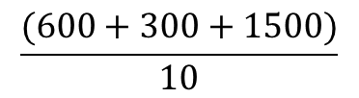
Example using DMSP
E.g. participant with 3 residences 10-20 years before enrolment
Residence 1 –
3 years
Residence 2 –
2 years
Residence 3 –
5 years
$$\frac{(600+300+1500)}{10}$$
$$=240 \text{nW}\text{/}\text{cm}\text{2/}\text{sr}$$
DMSP: 200 x 3 yrs
= 600
DMSP: 150 x 2 yrs
= 300
DMSP: 300 x 5 yrs
= 1500
Average cumulative DMSP value
over 10-yr period
Notes:
Here is an example of how a cumulative average of LAN was calculated, using DMSP as an example
A participant reported 3 residences 10-20 yrs before diagnosis, each with a corresponding DMSP value
Each DMSP value is multiplied by the time lived at that residence, to get a cumulative DMSP exposure for that residence
Each cumulative DMSP is then summed together and averaged over the total number of years, resulting in an average cumulative DMSP value over a 10-year period
Similar calculation used for other LAN variables
This time-weighted measure allowed us to accounts for changes in LAN due to changes in a participant’s address over the 10 year period
Notes:
All addresses were geocoded to longitude-latitude coordinates using the Google Maps database and an app available through Google, and the coordinates were then used to extract DNB measurements using calibrated DNB image data, as well as to extract MSI estimates from the radiance calibrated ISS photo.

Slide 20
Methods: LAN Measurements
Total of 8 measures of outdoor LAN
Overall outdoor LAN exposure:
1 measure using DNB data
1 measure using DMSP data
5 measures of melatonin suppression index (MSI) using ISS data (Aubé et al., 2013):
Wavelength-based lamp MSI estimates using blue-green (MSI-BG) or red-green color (MSI-GR) band ratios
Wavelength-and-intensity-based MSI estimates using blue-green (ImpMSI-BG) or red-green (ImpMSI-GR) color band ratios
1 measure of luminance using ISS data
Vancouver only
Notes:
In total, we looked at 8 measures of outdoor LAN:
We looked at overall outdoor LAN exposure using the DNB data, and the lower resolution DMSP data
We looked at 5 measures of melatonin suppression index (MSI) using the ISS data
We also looked at 1 measure of luminance (a measure similar to brightness), using the ISS data
No useable ISS data could be estimated for Kingston, ON
MSI variables and luminance could be not be calculated for Kingston participants. However, Kingston participants were included in the DNB and DMSP analyses.
Notes about light measurements:
DNB and DMSP: measured in nW/cm2/sr
Luminance: characterizes what a human visual system would call brightness if you are using color vision (units = nW/sr/cm2/Angstrom)
MSI-BG: an estimate of the Melatonin Suppression Index of the lamps, estimated using the blue-green band ratio. It does not consider the total amount of light, only the colour.
MSI-GR: an estimate of the Melatonin Suppression Index of the lamps, estimated using the green-red band ratio. It does not consider the total amount of light, only the colour.
ImpMSI-BG: an estimate of the Melatonin Suppression Index that also takes into account the brightness of the lamps, estimated using the blue-green ratio.
ImpMSI-GR: an estimate of the Melatonin Suppression Index that also takes into account the brightness of the lamps, estimated using the green-red ratio.
MSIClass: an estimate of the Melatonin Suppression Index that takes into account the brightness of the lamps, estimated using a best guess for the lamp technology (e.g. HSP, LED, etc.)
*MSI variables are unitless – 0 = no impact on melatonin suppression, and 1 = strong impact on melatonin suppression

Slide 21
Methods: Statistical Analysis
Outdoor LAN measures categorized into tertiles based on controls
Lowest tertile (darkest light level) as the reference
Logistic regression to estimate the relationship between outdoor LAN and risk of breast cancer
Polytomous logistic regression to estimate the relationship for breast cancer subtypes (ER/PR+ vs. ER/PR- vs. controls)
Adjusted for confounders chosen a priori
Reminder: Risk may be limited to pre-menopausal women, and estrogen/ progesterone receptor positive breast cancer
Potential high risk group: Night workers
Notes:
Outdoor LAN measures were categorized into tertiles, with tertile 1 representing the lowest (i.e. darkest) light level, and tertile 3 representing the brightest light level. Tertile 1 was used as the reference group in all analyses
Logistic regression was used to estimate the relationship between outdoor LAN and risk of breast cancer
Polytomous logistic regression was also used to estimate the relationship by using breast cancer subtypes (ER or PR positive vs. ER and PR negative, vs controls).
All models were adjusted for confounders that were chosen a priori
Notes:
- We originally wanted to use quintiles, since that is what the Nurses' Health Study used. However, we have a much smaller sample size than them, so we thought quartiles would be the best to use. However, due to the small sample size in some of the interactions we wanted to investigate (especially the ER/PR- negative group), I changed it to the 3 groups. Having more cases in each group using tertiles would mean we're more likely to detect a statistically significant effect, and would hopefully give a more stable OR estimate and 95% CI.

Slide 22
Results
Fully-adjusted models of LAN exposure and risk of breast cancer by ER/PR status, stratified by menopausal status
 |  | Pre-menopausal |  | Post-menopausal
 |  | ER/PR+ | ER/PR- | ER/PR+ | ER/PR-
Measure |  | OR (95% CI) | OR (95% CI) | OR (95% CI) | OR- (95% CI) | p-value - interaction
DNB | Tertile 1 | Ref. | Ref. | Ref. | Ref. | 0.03*
 | Tertile 2 | 1.75 (1.06, 2.90)* | 1.31 (0.63, 2.71) | 0.72 (0.52, 1.00) | 0.82 (0.51, 1.33)
 | Tertile 3 | 1.19 (0.73, 1.95) | 0.58 (0.26, 1.26) | 0.93 (0.67, 1.30) | 0.80 (0.48, 1.35)
 | Continuous (per IQR increase) | 1.14 (0.90, 1.44) | 0.80 (0.54, 1.18) | 0.96 (0.83, 1.11) | 0.84 (0.66, 1.07) | 0.40
DMSP | Tertile 1 | Ref. | Ref. | Ref. | Ref. | 0.16
 | Tertile 2 | 1.85 (1.14, 3.00)* | 0.87 (0.43, 1.79) | 0.92 (0.66, 1.28) | 0.97 (0.60, 1.57)
 | Tertile 3 | 1.15 (0.70, 1.90) | 0.57 (0.26, 1.25) | 0.80 (0.58, 1.11) | 0.71 (0.43, 1.18)
 | Continuous (per IQR increase) | 1.13 (0.85, 1.51) | 0.78 (0.49, 1.26) | 0.89 (0.73, 1.08) | 0.83 (0.62, 1.11) | 0.32
All models adjusted for age, ethnicity, family history of breast cancer, age at menarche, BMI, personal income, education, parity and age at first birth, years of oral contraceptive use, age at first mammography screening, smoking status, average alcohol intake, and hormone replacement therapy use
Notes:
- There is some (weak) evidence that pre-menopausal women who are exposed to higher levels of LAN may be associated with a higher risk of estrogen receptor or progesterone receptor positive breast cancer.
This finding would be similar to the Nurses’ Health Study, and is supported by hypotheses in the literature
However, we have to be careful in our interpretation – confidence intervals are wide
Chris suggested that the lower effect estimate seen in tertile 3 could be because people in higher LAN areas are more likely to use curtains, etc., to counteract the greater amount of light – however, this is obviously just speculation, and could be used to help ‘tell a story’ of the results, rather than make a conclusion
Notes:
I tried to add the sample size in for each group, but it makes the table very messy and hard to read on a slide

Slide 23
Results – Pre-menopausal Only
Measure |  | ER/PR+ (95% CI) | ER/PR- (95% CI)
Luminance | Tertile 1 | Ref. | Ref.
 | Tertile 2 | 1.05 (0.58, 1.87) | 0.51 (0.20, 1.27)
 | Tertile 3 | 1.14 (0.66, 1.99) | 0.56 (0.24, 1.32)
 | Continuous (per IQR increase) | 0.95 (0.77, 1.17) | 0.77 (0.52, 1.14)
MSI – Blue green | Tertile 1 | Ref. | Ref.
 | Tertile 2 | 0.74 (0.44, 1.23) | 0.53 (0.21, 1.32)
 | Tertile 3 | 1.15 (0.66, 2.00) | 1.64 (0.70, 3.80)
 | Continuous (per IQR increase) | 1.04 (0.79, 1.27) | 1.52 (0.96, 2.38)
MSI – Green red | Tertile 1 | Ref. | Ref.
 | Tertile 2 | 0.67 (0.40, 1.13) | 1.06 (0.44, 2.56)
 | Tertile 3 | 0.86 (0.50, 1.49) | 1.21 (0.47, 3.08)
 | Continuous (per IQR increase) | 0.98 (0.73, 1.32) | 1.16 (0.71, 1.88)
Notes:
Similar findings are not seen in LAN measures related to luminance and melatonin suppression indexes.

Slide 24
Results – Pre-menopausal Only
Measure |  | ER/PR+ (95% CI) | ER/PR- (95% CI)
ImpMSI – Blue green | Tertile 1 | Ref. | Ref.
 | Tertile 2 | 0.55 (0.32, 0.97)* | 0.90 (0.36, 2.29)
 | Tertile 3 | 0.79 (0.46, 1.36) | 0.89 (0.35, 2.27)
 | Continuous (per IQR increase) | 0.98 (0.85, 1.13) | 0.97 (0.76, 1.24)
ImpMSI – Green red | Tertile 1 | Ref. | Ref.
 | Tertile 2 | 0.42 (0.24, 0.76)* | 0.85 (0.34, 2.11)
 | Tertile 3 | 0.67 (0.38, 1.17) | 0.57 (0.22, 1.48)
 | Continuous (per IQR increase) | 1.02 (0.82, 1.26) | 0.88 (0.59, 1.33)
MSIClass | Tertile 1 | Ref. | Ref.
 | Tertile 2 | 0.72 (0.41 1.27) | 1.65 (0.65, 4.18)
 | Tertile 3 | 0.91 (0.53, 1.58) | 0.92 (0.34, 2.50)
 | Continuous (per IQR increase) | 0.99 (0.82, 1.20) | 0.85 (0.58, 1.26)
Notes:
Similar findings are not seen in LAN measures related to luminance and melatonin suppression indexes.

Slide 25
Results – Shift work
Fully-adjusted models of LAN exposure and risk of breast cancer by shift work status, stratified by menopausal status
 |  | Pre-menopausal |  | Post-menopausal
 |  | Non-shift worker | Shift worker | Non-shift worker | Shift worker
Measure |  | OR (95% CI) | OR (95% CI) | OR (95% CI) | OR- (95% CI)
DNB | Tertile 1 | Ref. | Ref. | Ref. | Ref.
 | Tertile 2 | 1.69 (0.87, 3.30) | 1.38 (0.67, 2.85) | 0.71 (0.49, 1.03) | 0.85 (0.50, 1.45)
 | Tertile 3 | 1.11 (0.57, 2.16) | 1.01 (0.50, 2.02) | 0.84 (0.57, 1.24) | 0.93 (0.53, 1.63)
 | Continuous (per IQR increase) | 1.01 (0.73, 1.41) | 1.15 (0.83, 1.59) | 0.89 (0.74, 1.07) | 0.95 (0.76, 1.18)
DMSP | Tertile 1 | Ref. | Ref. | Ref. | Ref.
 | Tertile 2 | 1.95 (1.03, 3.71)* | 1.29 (0.64, 2.60) | 0.71 (0.49, 1.04) | 1.65 (0.94, 2.87)
 | Tertile 3 | 0.89 (0.45, 1.75) | 0.91 (0.50, 1.83) | 0.64 (0.44, 0.94) | 1.06 (0.62, 1.81)
 | Continuous (per IQR increase) | 0.85 (0.56, 1.28) | 1.12 (0.75, 1.66) | 0.78 (0.62, 0.98) | 1.04 (0.76, 1.41)
All models adjusted for age, ethnicity, family history of breast cancer, age at menarche, BMI, personal income, education, parity and age at first birth, years of oral contraceptive use, age at first mammography screening, smoking status, average alcohol intake, and hormone replacement therapy use

Slide 26
Pre-menopausal
Post-menopausal
Measure |  | Non-shift (95% CI) | Shift (95% CI) | Non-shift 95% CI) | Shift (95% CI)
Luminance | Tertile 1 | Ref. | Ref. | Ref. | Ref.
 | Tertile 2 | 0.86 (0.39, 1.89) | 0.89 (0.38, 2.10) | 0.73 (0.48, 1.10) | 0.94 (0.49, 1.78)
 | Tertile 3 | 1.01 (0.46, 2.19) | 0.88 (0.40, 1.96) | 0.94 (0.60, 1.46) | 0.49 (0.25, 0.93)*
 | Continuous (per IQR increase) | 0.92 (0.68, 1.23) | 0.90 (0.65, 1.24) | 0.97 (0.82, 1.14) | 0.80 (0.60, 1.06)
MSI – Blue green | Tertile 1 | Ref. | Ref. | Ref. | Ref.
 | Tertile 2 | 0.97 (0.48, 1.98) | 0.45 (0.21, 0.98)* | 0.79 (0.51, 1.23) | 0.68 (0.34, 1.34)
 | Tertile 3 | 1.18 (0.55, 2.54) | 1.18 (0.51, 2.71) | 0.85 (0.56, 1.30) | 0.78 (0.42, 1.44)
 | Continuous (per IQR increase) | 1.22 (0.82, 1.81) | 0.97 (0.67, 1.41) | 0.94 (0.79, 1.12) | 0.86 (0.66, 1.12)
MSI – Green red | Tertile 1 | Ref. | Ref. | Ref. | Ref.
 | Tertile 2 | 0.64 (0.30, 1.36) | 0.75 (0.34, 1.64) | 0.63 (0.41, 0.97)* | 0.88 (0.45, 1.73)
 | Tertile 3 | 0.93 (0.43, 2.00) | 1.06 (0.48, 2.36) | 1.03 (0.67, 1.58) | 0.87 (0.47, 1.62)
 | Continuous (per IQR increase) | 1.04 (0.68, 1.57) | 1.06 (0.69, 1.62) | 0.93 (0.76, 1.12) | 0.93 (0.71, 1.21)
ImpMSI – Blue green | Tertile 1 | Ref. | Ref. | Ref. | Ref.
 | Tertile 2 | 0.88 (0.41, 1.89) | 0.40 (0.16, 0.91)* | 0.73 (0.48, 1.12) | 0.71 (0.38, 1.33)
 | Tertile 3 | 1.04 (0.48, 2.29) | 0.56 (0.25, 1.25) | 1.02 (0.66, 1.57) | 0.35 (0.18, 0.70)*
 | Continuous (per IQR increase) | 0.97 (0.79, 1.20) | 0.97 (0.79, 1.18) | 0.97 (0.86, 1.09) | 0.81 (0.66, 0.99)*
ImpMSI – Green red | Tertile 1 | Ref. | Ref. | Ref. | Ref.
 | Tertile 2 | 0.34 (0.15, 0.75)* | 0.61 (0.26, 1.45) | 0.92 (0.61, 1.40) | 0.61 (0.32, 1.16)
 | Tertile 3 | 0.66 (0.30, 1.47) | 0.58 (0.25, 1.35) | 1.00 (0.65, 1.55) | 0.49 (0.26, 0.94)*
 | Continuous (per IQR increase) | 1.05 (0.79, 1.39) | 0.95 (0.66, 1.35) | 1.01 (0.86, 1.19) | 0.87 (0.67, 1.34)
MSIClass | Tertile 1 | Ref. | Ref. | Ref. | Ref.
 | Tertile 2 | 0.71 (0.33 1.53) | 1.14 (0.48, 2.69) | 0.74 (0.49, 1.13) | 0.74 (0.40, 1.40)
 | Tertile 3 | 1.10 (0.50, 2.43) | 0.73 (0.33, 1.62) | 1.02 (0.66, 1.58) | 0.50 (0.26, 0.97)*
 | Continuous (per IQR increase) | 0.97 (0.76, 1.24) | 0.98 (0.71, 1.36) | 0.99 (0.85, 1.16) | 0.90 (0.69, 1.16)

Slide 27
Results – Night Work
Fully-adjusted models of LAN exposure associated with risk of breast cancer by night work status, stratified by menopausal status
 |  | Pre-menopausal |  | Post-menopausal
 |  | Day worker | Night worker | Day worker | Night worker
Measure |  | OR (95% CI) | OR (95% CI) | OR (95% CI) | OR (95% CI)
DNB | Tertile 1 | Ref. | Ref. | Ref. | Ref.
 | Tertile 2 | 1.21 (0.69, 2.12) | 3.30 (1.20, 9.10)* | 0.70 (0.50, 0.99)* | 0.91 (0.45, 1.85)
 | Tertile 3 | 0.92 (0.53, 1.60) | 1.72 (0.66, 4.50) | 0.77 (0.54, 1.11) | 1.41 (0.67, 2.97)
 | Continuous (per IQR increase) | 1.10 (0.83, 1.46) | 1.02 (0.69, 1.53) | 0.87 (0.74, 1.01) | 1.11 (0.81, 1.53)
DMSP | Tertile 1 | Ref. | Ref. | Ref. | Ref.
 | Tertile 2 | 1.52 (0.88, 2.61) | 1.98 (0.78, 5.07) | 0.78 (0.55, 1.11) | 2.14 (1.02 4.51)*
 | Tertile 3 | 0.91 (0.51, 1.63) | 1.01 (0.42, 2.43) | 0.72 (0.51, 1.02) | 0.89 (0.43, 1.83)
 | Continuous (per IQR increase) | 0.97 (0.69, 1.36) | 1.08 (0.65, 1.81) | 0.84 (0.68, 1.03) | 0.94 (0.63, 1.40)
All models adjusted for age, ethnicity, family history of breast cancer, age at menarche, BMI, personal income, education, parity and age at first birth, years of oral contraceptive use, age at first mammography screening, smoking status, average alcohol intake, and hormone replacement therapy use
Notes:
Notes:
I tried to add the sample size in for each group, but it makes the table very messy and hard to read on a slide

Slide 28
Pre-menopausal
Post-menopausal
Measure |  | Day worker (95% CI) | Night work (95% CI) | Day worker (95% CI) | Night worker (95% CI)
Luminance | Tertile 1 | Ref. | Ref. | Ref. | Ref.
 | Tertile 2 | 0.78 (0.40, 1.50) | 0.80 (0.26, 2.46) | 0.81 (0.55, 1.18) | 0.68 (0.28, 1.65)
 | Tertile 3 | 1.09 (0.57, 2.09) | 0.56 (0.19, 1.63) | 0.79 (0.53, 1.19) | 0.67 (0.29, 1.53)
 | Continuous (per IQR increase) | 0.99 (0.75, 1.29) | 0.75 (0.51, 1.29) | 0.92 (0.78, 1.09) | 0.91 (0.69, 1.22)
MSI – Blue green | Tertile 1 | Ref. | Ref. | Ref. | Ref.
 | Tertile 2 | 0.60 (0.33, 1.10) | 0.82 (0.31, 2.20) | 0.71 (0.47, 1.05) | 1.16 (0.46, 2.94)
 | Tertile 3 | 0.95 (0.50, 1.81) | 1.84 (0.65, 5.18) | 0.80 (0.54, 1.17) | 1.03 (0.46, 2.34)
 | Continuous (per IQR increase) | 0.98 (0.71, 1.33) | 1.41 (0.84, 2.34) | 0.89 (0.76, 1.05) | 0.99 (0.71, 1.38)
MSI – Green red | Tertile 1 | Ref. | Ref. | Ref. | Ref.
 | Tertile 2 | 0.57 (0.31, 1.07) | 0.94 (0.35, 2.52) | 0.65 (0.44, 0.97)* | 0.85 (0.35, 2.10)
 | Tertile 3 | 1.01 (0.54, 1.90) | 0.63 (0.21, 1.89) | 0.99 (0.67, 1.46) | 0.91 (0.40, 2.08)
 | Continuous (per IQR increase) | 1.01 (0.72, 1.42) | 1.01 (0.56, 1.85) | 0.94 (0.79, 1.11) | 0.89 (0.62, 1.27)
ImpMSI – Blue green | Tertile 1 | Ref. | Ref. | Ref. | Ref.
 | Tertile 2 | 0.50 (0.26, 0.96)* | 0.73 (0.25, 2.15) | 0.75 (0.51, 1.10) | 0.62 (0.27, 1.43)
 | Tertile 3 | 0.85 (0.44, 1.65) | 0.54 (0.18, 1.57) | 0.80 (0.54, 1.19) | 0.56 (0.23, 1.38)
 | Continuous (per IQR increase) | 1.04 (0.86, 1.26) | 0.83 (0.62, 1.12) | 0.92 (0.83, 1.04) | 0.89 (0.74, 1.08)
ImpMSI – Green red | Tertile 1 | Ref. | Ref. | Ref. | Ref.
 | Tertile 2 | 0.30 (0.15, 0.59)* | 1.04 (0.33, 3.34) | 0.87 (0.60, 1.28) | 0.57 (0.23, 1.37)
 | Tertile 3 | 0.60 (0.30, 1.19) | 0.62 (0.20, 1.99) | 0.83 (0.55, 1.24) | 0.78 (0.34, 1.78)
 | Continuous (per IQR increase) | 1.12 (0.86, 1.46) | 0.71 (0.44, 1.14) | 0.96 (0.82, 1.12) | 1.01 (0.76, 1.35)
MSIClass | Tertile 1 | Ref. | Ref. | Ref. | Ref.
 | Tertile 2 | 0.62 (0.33, 1.20) | 1.30 (0.41, 4.12) | 0.71 (0.48, 1.04) | 0.98 (0.41, 2.31)
 | Tertile 3 | 1.10 (0.57, 2.13) | 0.44 (0.14, 1.38) | 0.83 (0.56, 1.24) | 0.81 (0.35, 1.89)
 | Continuous (per IQR increase) | 1.07 (0.84, 1.36) | 0.74 (0.48, 1.14) | 0.95 (0.82, 1.10) | 1.06 (0.78, 1.42)

Slide 29
Other Results
No clear patterns found when examining ISS data and breast cancer risk
By menopausal status, while considering ER/PR status
By menopausal status and night work
Similar findings using other exposure windows
10 to 25 years before diagnosis
10 to 30 years before diagnosis
Notes:
10 to 20 year time period was chosen for all analyses since this exposure period had the strongest effect estimates for the menopausal and ER/PR analysis. In a sensitivity analysis, I found that measurements taken 10-25 years and 10-30 years before study entry produced similar findings, but had weaker effect estimates.
Similar findings were also found when restricting the night work and shift work analyses to ER/PR+ cases only
Notes:
In case someone asks - For people to be included in the analysis (10-20 years exposure window), they needed to have at least 1 useable address during the exposure window. This means that most of the participants do not have outdoor LAN exposure based on their full residential history during that time. For our future publication, we can only consider doing a sensitivity analysis excluding those with who do not residential information for the full time period.
Nurses’ Health Study II did not specify exposure window like we did, and did not account for lag-time (or at least it’s not mentioned in the paper).
Similar with the Spain study – they used the longest duration household, and did not account for lag-time

Slide 30
Conclusions
DMSP and DNB
Weak evidence that outdoor LAN at residences is associated with breast cancer among pre-menopausal women
Estrogen/progesterone receptor positive breast cancer
Night workers may be at a higher risk
ISS
More precise measure of LAN at home
No clear link with breast cancer risk
More work needed to understand spectral parameters in relation to breast cancer risk
Notes:
Similar finding to Nurses Health and Spain – but at higher latitude
Past comment from Mike, that warrants some consideration:
By using a more precise measure of LAN, we are actually using a measure that would be a poorer proxy for the community effect (e.g. street lighting on the roads they drive on) and a better proxy for outdoor light intrusion. We need to comment on this on and on our contribution to understanding exactly what aspect of light exposure might be important. For example, James et al. found LAN to impact only shift workers and they used the lower-resolution DMSP, so their findings could indicate that breast cancer risk is raised by strong lighting on the roads that shift-workers drive on when coming home from work. By using measures with higher spatial resolution and by not focusing on shift-workers, we are not looking for such an effect. Therefore, if we have findings that are not consistent with James et al, we need to consider how our focus on a different aspect of light at night can tell a different part of the story (e.g., the effect really isn’t about light intrusion into bedrooms, but is a proxy for nighttime community activity).

Slide 31
Challenges
What are we truly capturing?
Higher resolution data:
Is this a “better” exposure measure at the individual level?
E.g. could represent light intrusion into bedrooms?
Maybe those at higher light levels use “protective gear” such as blinds, masks?
Lower resolution data:
Is this a “better” exposure measure at the community level?
E.g. could be a proxy for night-time activity?
Cumulative average may not be capturing relevant patterns of exposure
Notes:
Past comment from Mike, that warrants some consideration:
By using a more precise measure of LAN, we are actually using a measure that would be a poorer proxy for the community effect (e.g. street lighting on the roads they drive on) and a better proxy for outdoor light intrusion. We need to comment on this on and on our contribution to understanding exactly what aspect of light exposure might be important. For example, James et al. found LAN to impact only shift workers and they used the lower-resolution DMSP, so their findings could indicate that breast cancer risk is raised by strong lighting on the roads that shift-workers drive on when coming home from work. By using measures with higher spatial resolution and by not focusing on shift-workers, we are not looking for such an effect. Therefore, if we have findings that are not consistent with James et al, we need to consider how our focus on a different aspect of light at night can tell a different part of the story (e.g., the effect really isn’t about light intrusion into bedrooms, but is a proxy for nighttime community activity).

Slide 32
More Challenges!
LAN data measured in 2010-2013:
Good proxies for past exposure?
What is etiologically relevant exposure time window?
Reference level of light:
Too light? No one is unexposed
Range of exposures too small to detect cancer effect?
Chronotype:
Potential effect modifier not captured here
Notes:
Past comment from Mike, that warrants some consideration:
By using a more precise measure of LAN, we are actually using a measure that would be a poorer proxy for the community effect (e.g. street lighting on the roads they drive on) and a better proxy for outdoor light intrusion. We need to comment on this on and on our contribution to understanding exactly what aspect of light exposure might be important. For example, James et al. found LAN to impact only shift workers and they used the lower-resolution DMSP, so their findings could indicate that breast cancer risk is raised by strong lighting on the roads that shift-workers drive on when coming home from work. By using measures with higher spatial resolution and by not focusing on shift-workers, we are not looking for such an effect. Therefore, if we have findings that are not consistent with James et al, we need to consider how our focus on a different aspect of light at night can tell a different part of the story (e.g., the effect really isn’t about light intrusion into bedrooms, but is a proxy for nighttime community activity).

Slide 33
Future Challenges
Take into account individual behaviours related to LAN exposure as well as ambient outdoor light
Larger studies needed to assess risk within subgroups (to reduce heterogeneity) according to biological plausibility
Need to assess interactions between these subgroups (e.g. pre/post-menopausal night/day workers with ER/PR+/- breast cancers)
Notes:
Past comment from Mike, that warrants some consideration:
By using a more precise measure of LAN, we are actually using a measure that would be a poorer proxy for the community effect (e.g. street lighting on the roads they drive on) and a better proxy for outdoor light intrusion. We need to comment on this on and on our contribution to understanding exactly what aspect of light exposure might be important. For example, James et al. found LAN to impact only shift workers and they used the lower-resolution DMSP, so their findings could indicate that breast cancer risk is raised by strong lighting on the roads that shift-workers drive on when coming home from work. By using measures with higher spatial resolution and by not focusing on shift-workers, we are not looking for such an effect. Therefore, if we have findings that are not consistent with James et al, we need to consider how our focus on a different aspect of light at night can tell a different part of the story (e.g., the effect really isn’t about light intrusion into bedrooms, but is a proxy for nighttime community activity).

Slide 34






Acknowledgements
All study participants
Alejandro Sánchez de Miguel, Environment and Sustainability Institute, University of Exeter
Funding: Canadian Institutes of Health Research; Breast Cancer Action Kingston; DAAD German Faculty Research Exchange

Slide 36
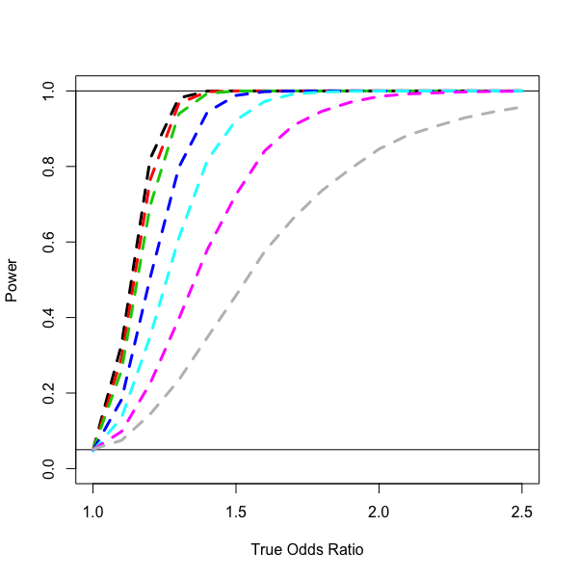
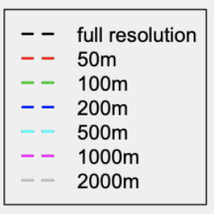
Notes:
Panel 1: Power decreases as resolution decreases.
That is, the probability of us finding a significant relationship between “brightness” and cancer risk goes down substantially as resolution decreases.
For example, if the true relationship between brightness and and cancer risk is an OR of 1.2 per standard deviation (i.e., if every standard deviation increase in “true” brightness results in a 20% increase in the odds of cancer), then, based on samples of size N=1000, we have the following probabilities of rejecting the null hypothesis and concluding that brightness and cancer risk are related:
- 82% if we are using true (full resolution) brightness
- 76% if we are using brightness measured with resolution of 50m
- 70% if we are using brightness measured with resolution of 100m
- 50% if we are using brightness measured with resolution of 200m
- 35% if we are using brightness measured with resolution of 500m
- 23% if we are using brightness measured with resolution of 1000m
- 14% if we are using brightness measured with resolution of 2000m
As another example, if the true OR is 1.3, the probabilities of reaching statistical significance in a sample of size N=1000 are as follows:
- 98% if we are using true (full resolution) brightness
- 97% if we are using brightness measured with resolution of 50m
- 94% if we are using brightness measured with resolution of 100m
- 80% if we are using brightness measured with resolution of 200m
- 61% if we are using brightness measured with resolution of 500m
- 40% if we are using brightness measured with resolution of 1000m
- 23% if we are using brightness measured with resolution of 2000m
So, if we use lower-resolution imagery to identify a relationship between LAN and cancer, then we are much more likely to falsely conclude that there is no relationship (the sample size would need to be correspondingly increased to make up for this loss of resolution).

Slide 37
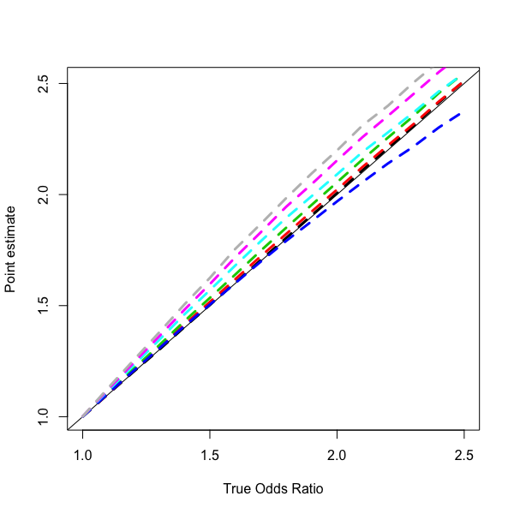
Notes:
Panel 2: There is bias in the estimators that rely on lower-resolution images.
You can see that the estimated ORs (dashed lines) differ from the true OR (solid line) whenever the lower-resolution data are used. For the most part, the bias increases as the true relationship gets stronger (OR going from 1 to 2.5 per SD) and the bias tends to increase as resolution decreases. Also, for the most part, the use of lower-resolution images tends to result in over estimation of the relationship (the dashed lines are mostly above the solid line). However, something different seems to be happening with the 200m resolution (the blue dashed line); using the 200m resolution tends to result in an underestimation of the relationship between brightness and cancer risk. I don’t know why this situation would be so different from the others. I am going to continue to look for possible errors in my code, though I haven’t seen anything yet.

Slide 38
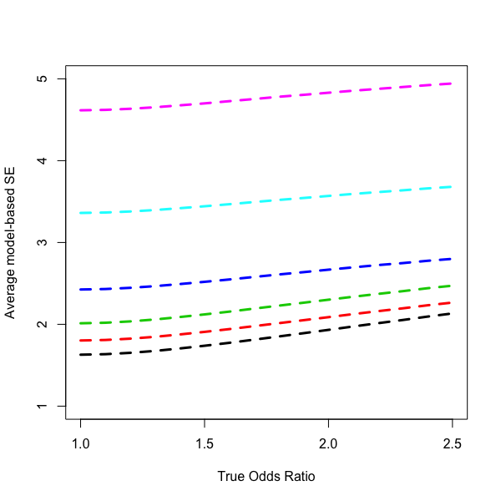
Notes:
Panel 3: The estimators that rely on lower-resolutions have much higher variances.
This is what explains the drop in power shown in panel 1. Another way of putting this would be that the corresponding 95% CIs are much much wider when using lower-resolution exposure.

Slide 39
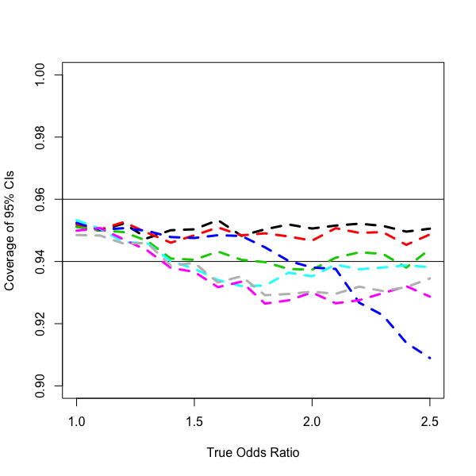
Notes:
Panel 4: 95% CIs are not quite right when using lower-resolution exposure.
When the relationship of interest is strong and lower-resolution exposure is used, the variance of the estimators is slightly larger than what would be expected by the model, so CIs are slightly too short. For example, when the true OR was 2.5, supposedly 95% CIs constructed based on the 200m resolution data (blue dashed line) tended to actually be something like 91% CIs (again, because variance is underestimated since it isn’t accounting for the measurement error in the exposure).

